Slide 1
the art of curriculum design:
Through the use of a curriculum wheel

Slide 2
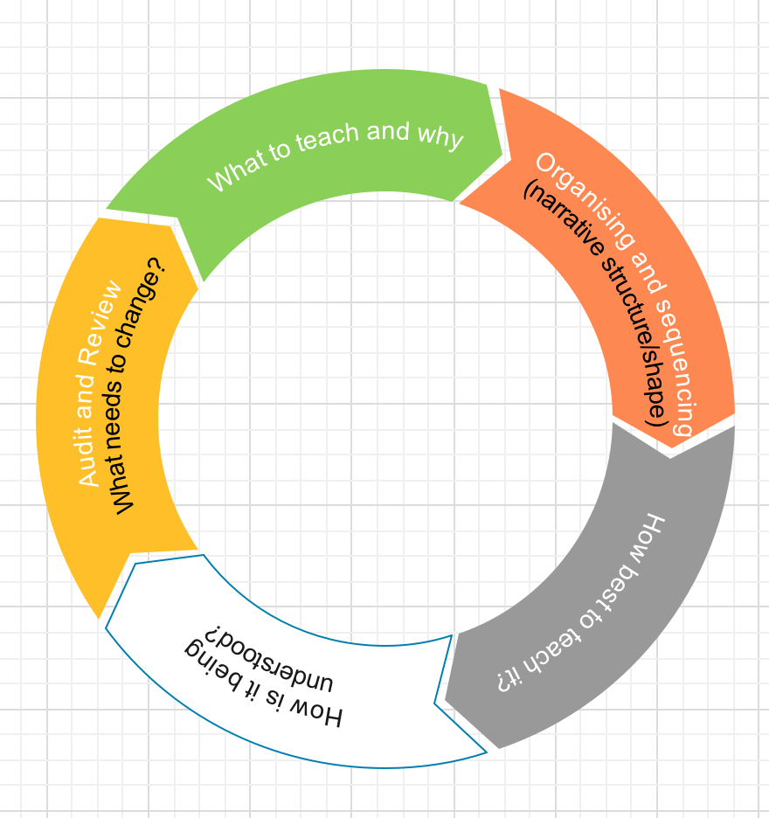

Slide 3
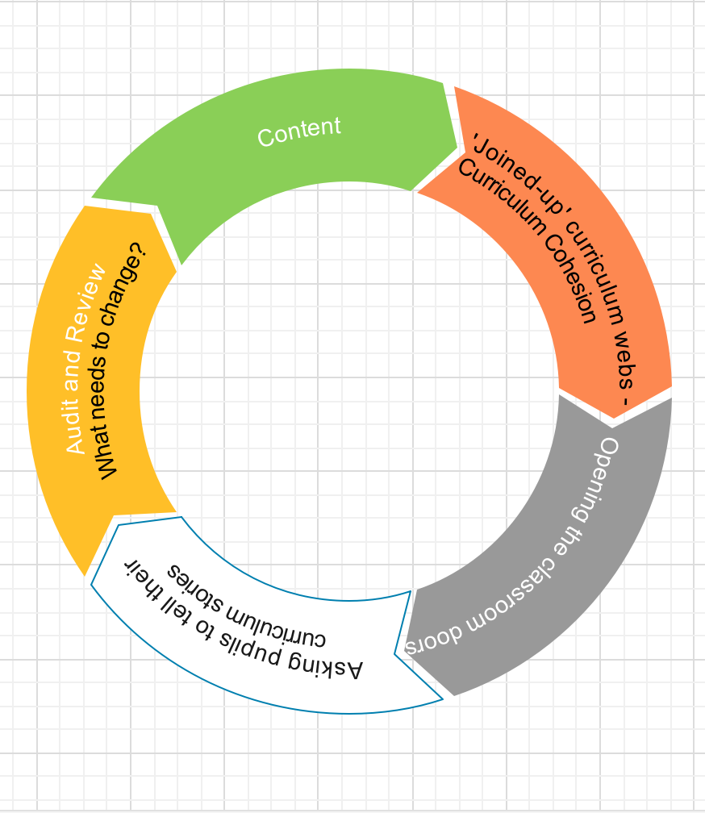

Slide 4
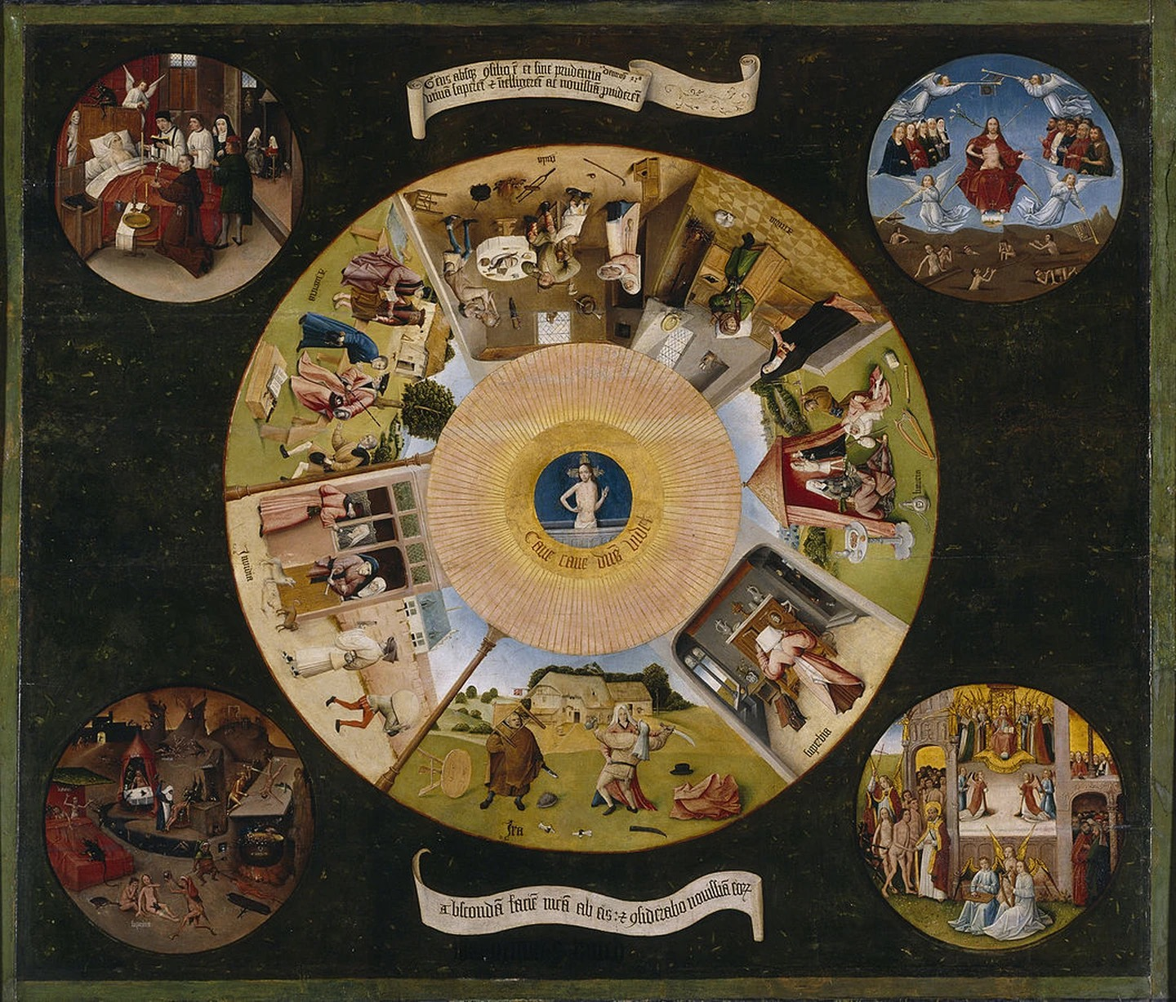

Slide 5
curriculum continuum

Slide 6
Where are you on the continuum?

Slide 7
Where are you on the continuum?
Teacher Autonomy
Scripted lessons

Slide 8
1 2 3 4 5 6 7 8 9 10
Teacher Autonomy
Scripted lessons

Slide 9
1 2 3 4 5 6 7 8 9 10
Free
Robotic

Slide 10
Where are you on the continuum?
Anarchy
Authoritarian

Slide 11
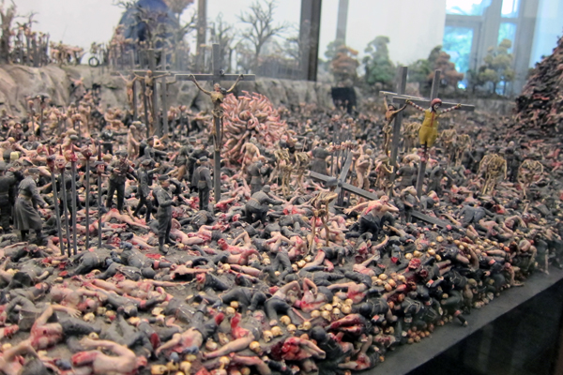
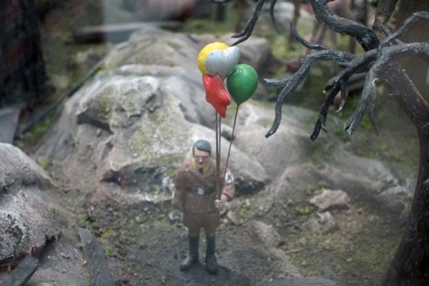

Slide 12
curriculum cohesion

Slide 14
JOINED-UP CURRICULUM
Agreed vision for progress through curriculum.
Agreed terminology.
‘This is the way we do things here’
Essentially collaborative within and across disciplines

Slide 15
relay
Handing the baton on…
Each teacher knows the rest of the story, they are presenting a chapter…
Can refer forwards and backwards… and across…

Slide 16
collaborative culture

Slide 17
forming the teams

Slide 18
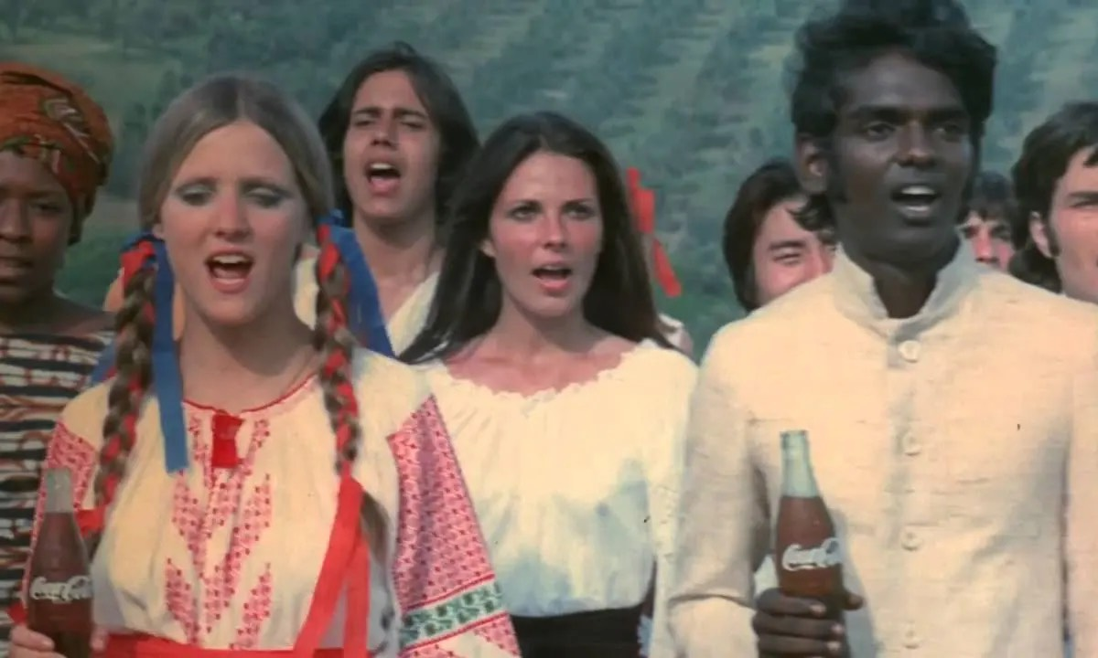

Slide 20
curriculum wheel

Slide 22
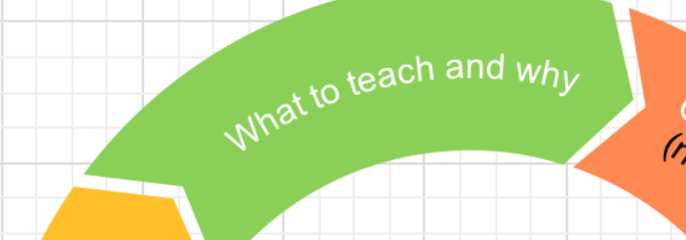
What to teach and why?

Slide 24
why?

Slide 25
w.e.b. dubois
the talented tenth
Men shall we make only as we make manhood the object of the work of the schools - intelligence, broad sympathy, knowledge of the world that was and is, and of the relation of men to it - this is the curriculum… which must underlie true life… the object of true education is not to make men carpenters, it is to make carpenters men.
washington et al, 1903, the negro problem, pp 33-34, 63

Slide 26
A Talk to Teachers
James Baldwin
The purpose of education... is to create in a person the ability to look at the world for himself, to make his own decisions, to say to himself this is black or this is white... [this] is the way he achieves his own identity.
Article. By James Baldwin. October 16, 1963.

Slide 27
what?

Slide 28
the best

Slide 29
powerful knowledge

Slide 30
cultural literacy

Slide 31
cultural capital

Slide 33
Teach cultural mobility
Athena vs the machine
…Instead of assuming that a person can only have one perspective on the world… cultural mobility accepts that we have more than one way of being in the world… Curriculum opens up a wide variety of perspectives to one and all…

Slide 34
Identity vs Knowledge
Should your curriculum be:
Local
National
International
Encyclopaedic
Cosmopolitan
Perspectival
Dialectical

Slide 35
Knowledge, Skills and Competencies

Slide 36
Novice Expert

Slide 38
futbol de salao (“soccer in the room”)
The ball is smaller and heavier—creating more control. The field is tiny—putting a premium on vision, anticipation, and quick, accurate passes. The play is lightning-fast—forcing players to anticipate and adapt. Futbol de salao uses deep practice to build skills at high velocity.

Slide 39
culture, knowledge and decolonisation

Slide 41
Aijaz Ahmad
The Politics of Culture
Culture… is not an arena for harmonious unfolding of the National Spirit, as is often supposed by those who borrow their nationalist vocabulary from German Romanticism. Nor is ‘Culture’ simply a zone of the aesthetic. It is a field, rather, of contention and conflict, among classes and among other social forces that struggle for dominance.

Slide 42
Aijaz Ahmad
The Politics of Culture
Every nation has at any given time not one culture but several, and these contentions take not only the benign form of ‘unity in diversity’, as our nationalism presupposes, but also as unity of opposites. In today’s context, then, we have to reject certain kinds of cultural nationalism and fashion for ourselves a different kind.

Slide 43
Chimamanda Ngozi Adichie:
From: we should all be feminists
Culture functions ultimately to ensure the preservation and continuity of a people.
In my family, I am the child who is most interested… in our tradition...
But I cannot participate, because Igbo culture privileges men...
If it is true that the full humanity of women is not our culture, then we can and must make it our culture.

Slide 44
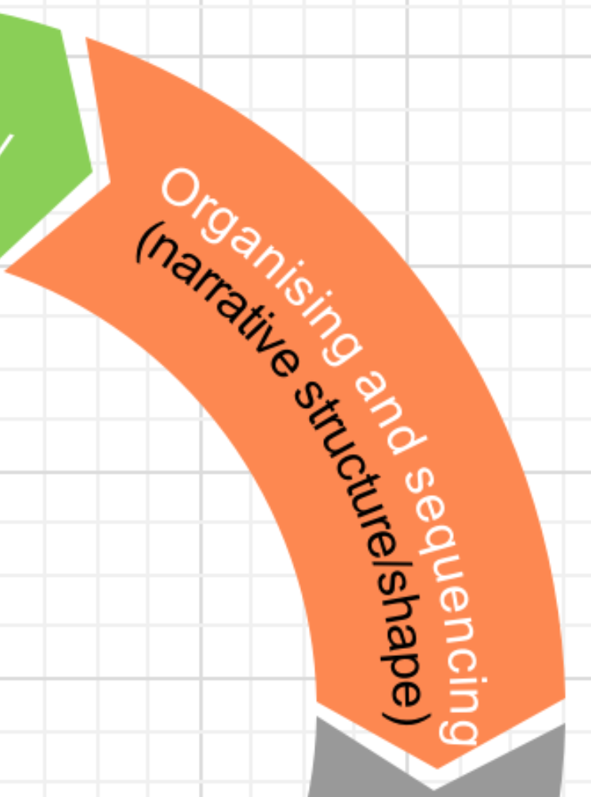
Organising and sequencing

Slide 46
curriculum shapes

Slide 48
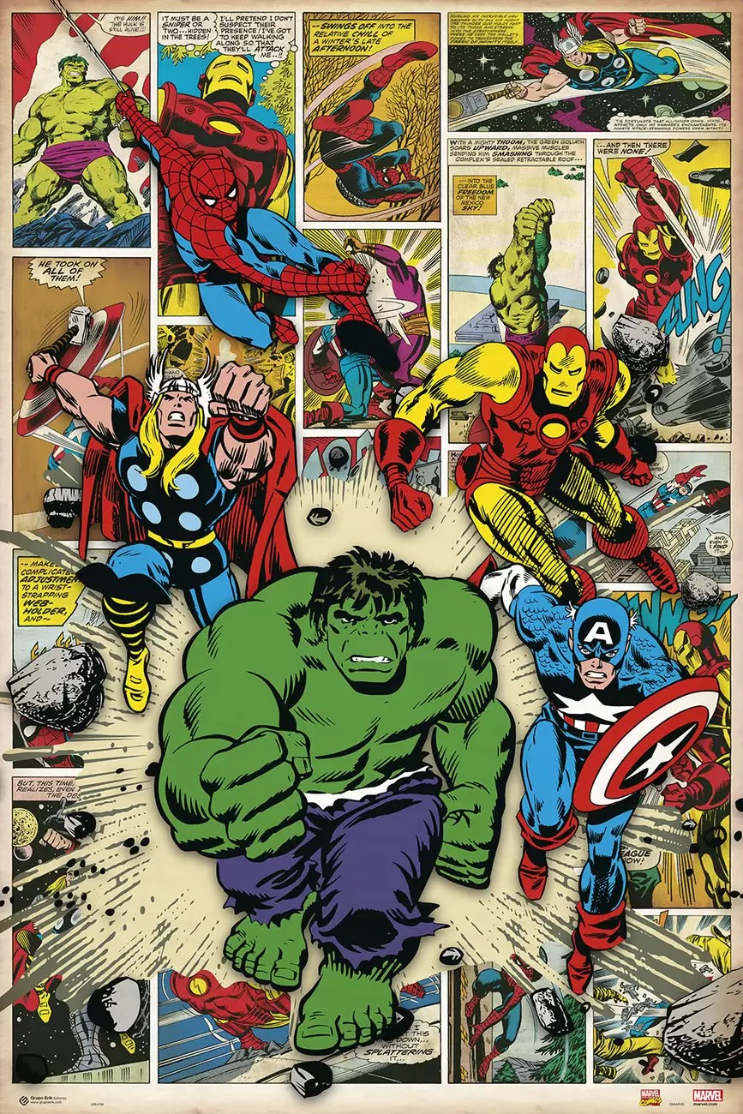
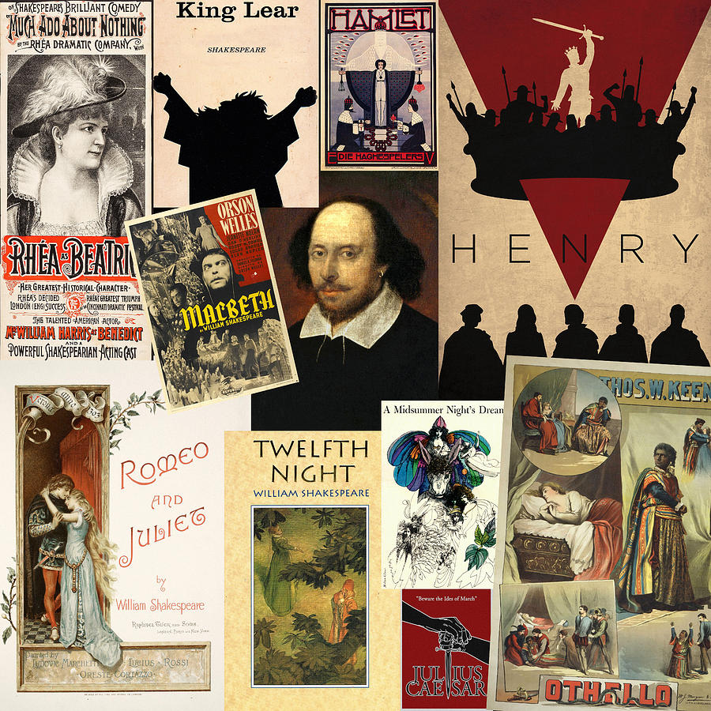

Slide 49
schema
Frederic bartlett
People organise concepts into mental constructs/schemas.
Schemas help people process and remember information.
New information that fits their existing schema, is more easily understood and therefore recalled.
Information that doesn’t fit into an existing schema can be easily forgotten.

Slide 51
Simon Jenkins
A short history of europe…
Depth should follow breadth, for without it history is meaningless.

Slide 52
T

Slide 53
T
Shape

Slide 54
T
Relationship between breadth and depth
Shape

Slide 56
Context (Breadth)

Slide 57
Context (Breadth)
The Point (Depth)

Slide 58
Context (Breadth)
Organising Concepts and Principles
The Point (Depth)

Slide 59
Context (Breadth)
Organising Concepts and Principles
Knowledge organised through the ‘upside-down triangle’
The Point (Depth)

Slide 60
Vehicles

Slide 61
Vehicles
Cars

Slide 62
Vehicles
Cars
Sports Cars

Slide 63
Vehicles
Cars
Sports Cars
British Sports Cars

Slide 64
Vehicles
Cars
Sports Cars
British Sports Cars
British sports cars in 1960’s - 70’s

Slide 65
Vehicles
Cars
Sports Cars
British Sports Cars
British sports cars in 1960’s - 70’s
MG

Slide 67
Frankenstein curriculum
How else to approach it?
What is a novel?

Slide 68
The Enlightenment
Romanticism
The Gothic
Frankenstein

Slide 69
The Enlightenment
Romanticism
The Gothic
Jane Eyre

Slide 70
Gothic
Horror
Frankenstein
Science Fiction

Slide 71
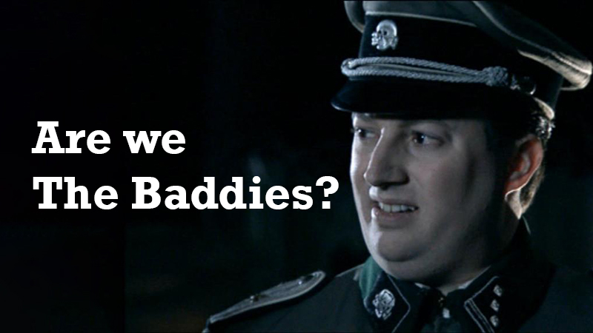

Slide 72
Spiral curriculum
design model
Topics revisited in increasing complexity.
Each spiral interleaves with other spirals.
The distance between visits increases as time goes by…

Slide 73
Dialectics
Christopher Hitchens:
When there is a basic grasp of narration and evolution and a corresponding grasp of differing views of the same story… we have the practice of teaching by dialectics

Slide 74
Empire

Slide 75
Empire and Colonialism

Slide 76
clr james
I denounce European colonialism… but I respect the learning and the profound discoveries of Western civilisation.

Slide 77
Empire and Colonialism
Empire and Colonialism
Roman
British

Slide 78
robert björk
(Intelligent) interleaving
… juxtaposition, which allows for discrimination processes, is more critical to inductive learning than simple temporal spacing…
noticing commonalities and differences.

Slide 79
robert björk
interleaving
PERFORMANCE IS ENHANCED IN THE LONG TERM THROUGH INTERLEAVED PRACTICE…
Better for the ability to transfer learning too.
STUDENTS ABLE TO DISCRIMINATE BETTER.

Slide 81
Truth - Realism
Truth - Social
Truth - Spiritual
Stanislavski
Brecht
Artaud
Fourth Wall
Break Fourth wall
Engulfing
Effect on Audience

Slide 82
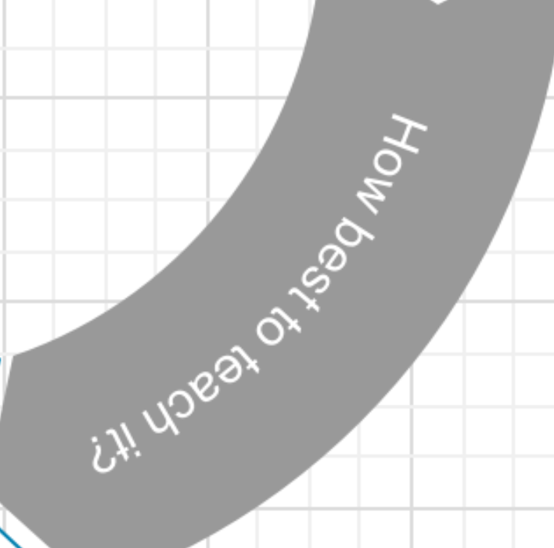
pedagogy (How best to teach)

Slide 83
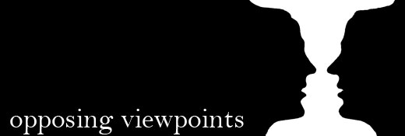
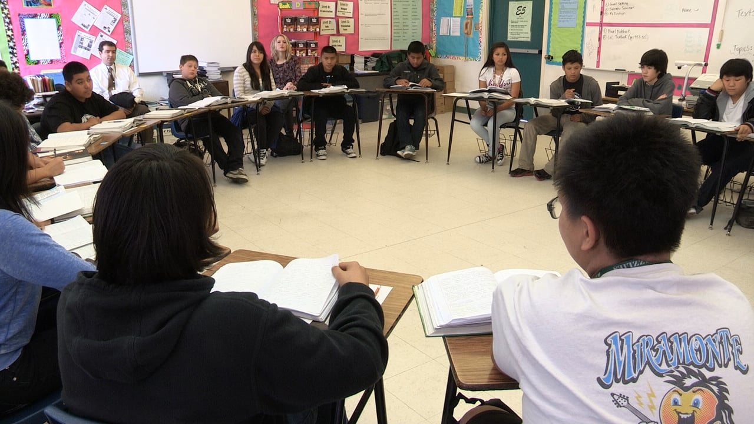
AN OPPORTUNITY TO DEVELOP QUALITATIVE JUDGEMENTS
Dissoi-Logoi
Socratic Seminar

Slide 85
the essay
montaigne
Let… him put what he has learned into a hundred several forms, and accommodate it to so many several subjects, to see if he yet rightly comprehends it, and has made it his own…
OF THE EDUCATION OF CHILDREN

Slide 86
FRIEDRICH NIETZSCHE
philologist and philosopher
There is only a perspectival seeing, only a perspectival knowing;
and the more affects we allow to speak about a matter, the more eyes,
different eyes, we know how to bring to bear on one and the same matter,
that much more complete will our concept of this matter, our objectivity be.
On the Genealogy of Morality: A Polemic.

Slide 88
the things themselves

Slide 89
the things themselves

Slide 92
Paul gilroy
Holberg Prize winner for 2019
People don’t belong in monocultures based on their colour etc… saying ‘this is what they like/think’ is over-determination
Culture is historically made, place, people, things, habits, traditions, desires, arguments, imaginations
Interviewed on receiving the prize. You tube

Slide 93
the essay
montaigne
If I speak of myself in different ways, that is because I look at myself in different ways…
Essai

Slide 94
Two roads diverged in a wood, and I
—I took the one less travelled by,
And that has made all the difference.

Slide 95
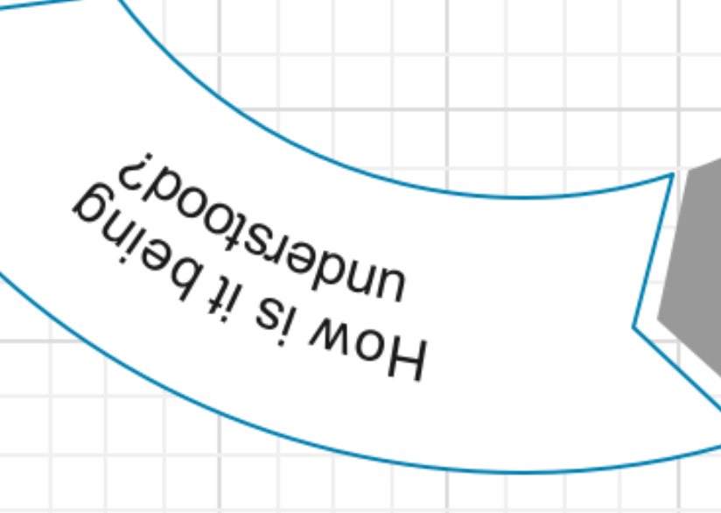
How well is the curriculum being understood?

Slide 97
A Talk to Teachers
James Baldwin
The purpose of education... is to create in a person the ability to look at the world for himself, to make his own decisions, to say to himself this is black or this is white... [this] is the way he achieves his own identity.
Article. By James Baldwin. October 16, 1963.

Slide 98
Two roads diverged in a wood, and I
—I took the one less traveled by,
And that has made all the difference.

Slide 99
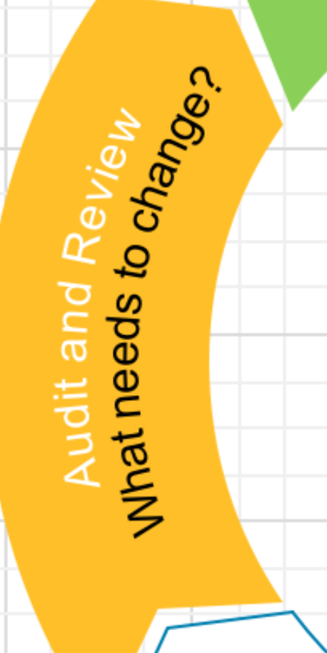
Audit and Review

