Slide 1
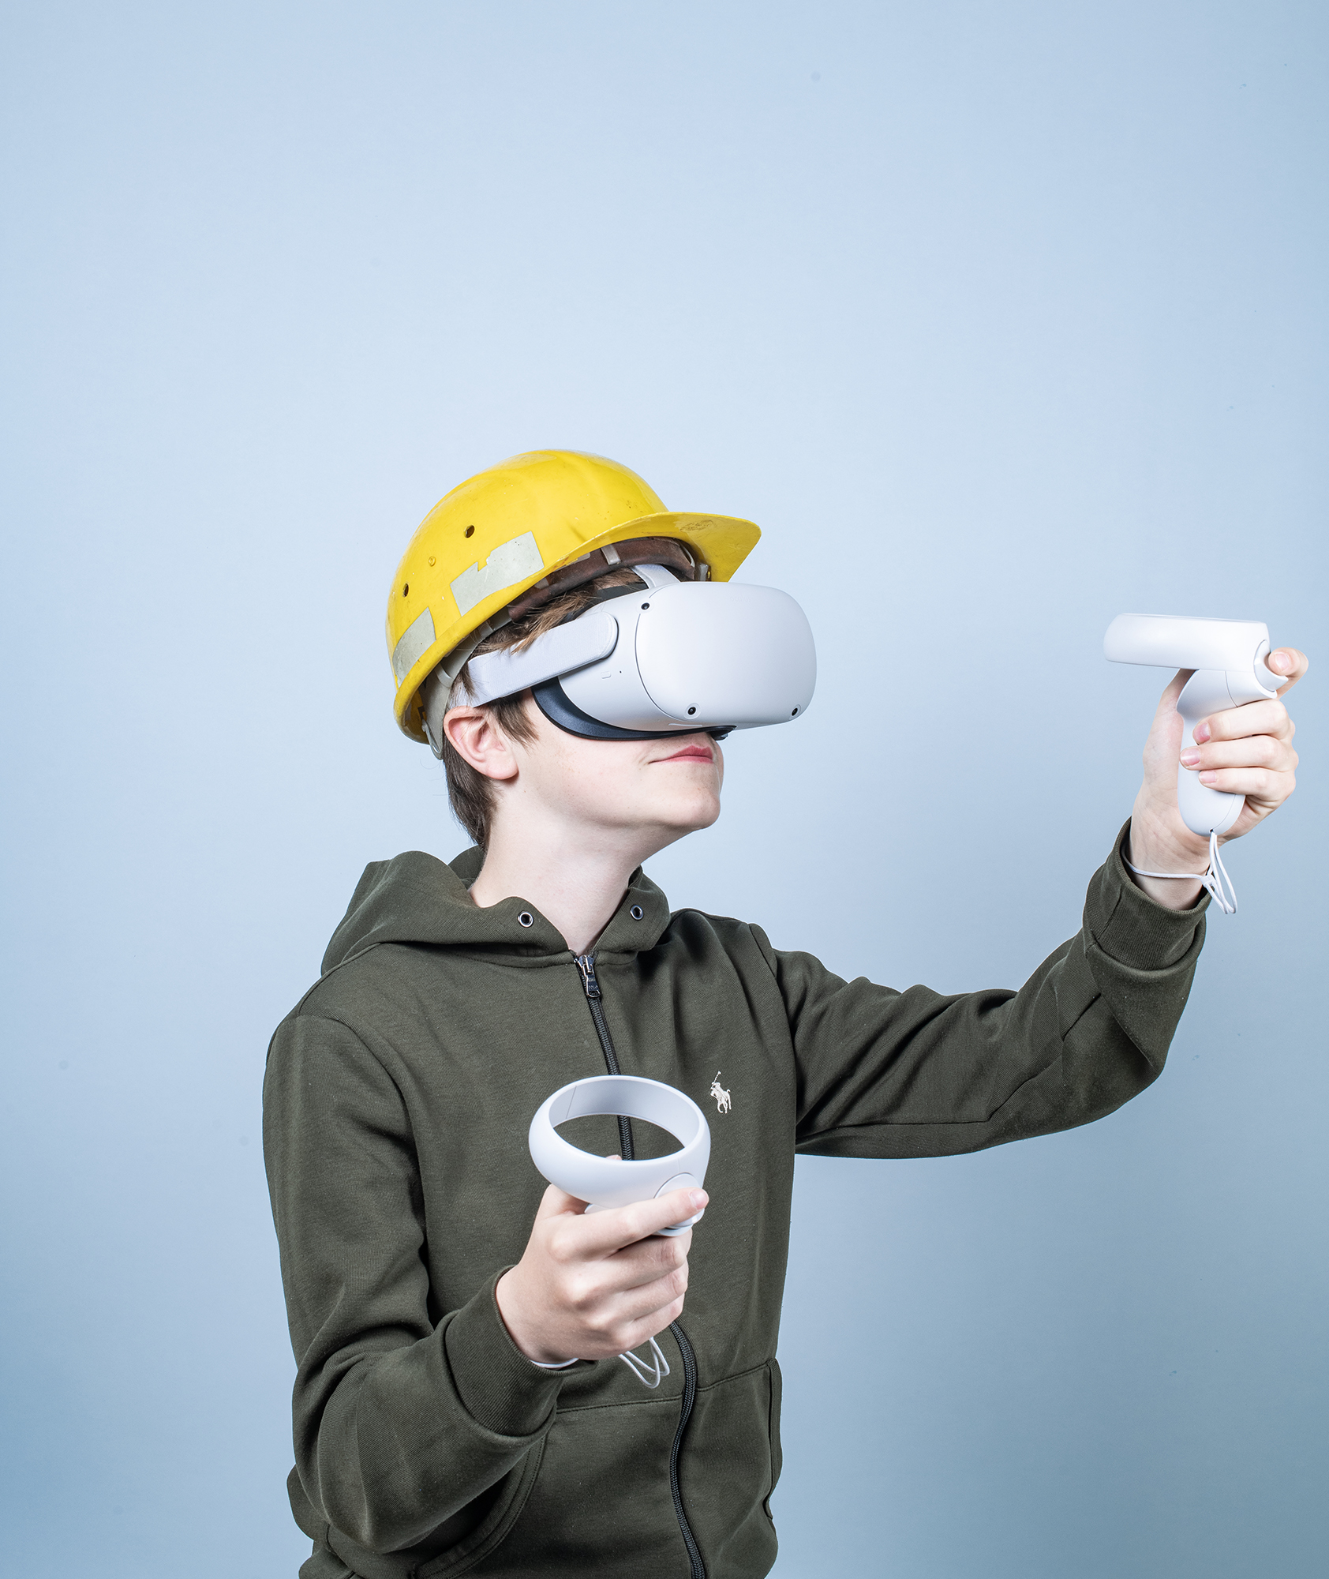
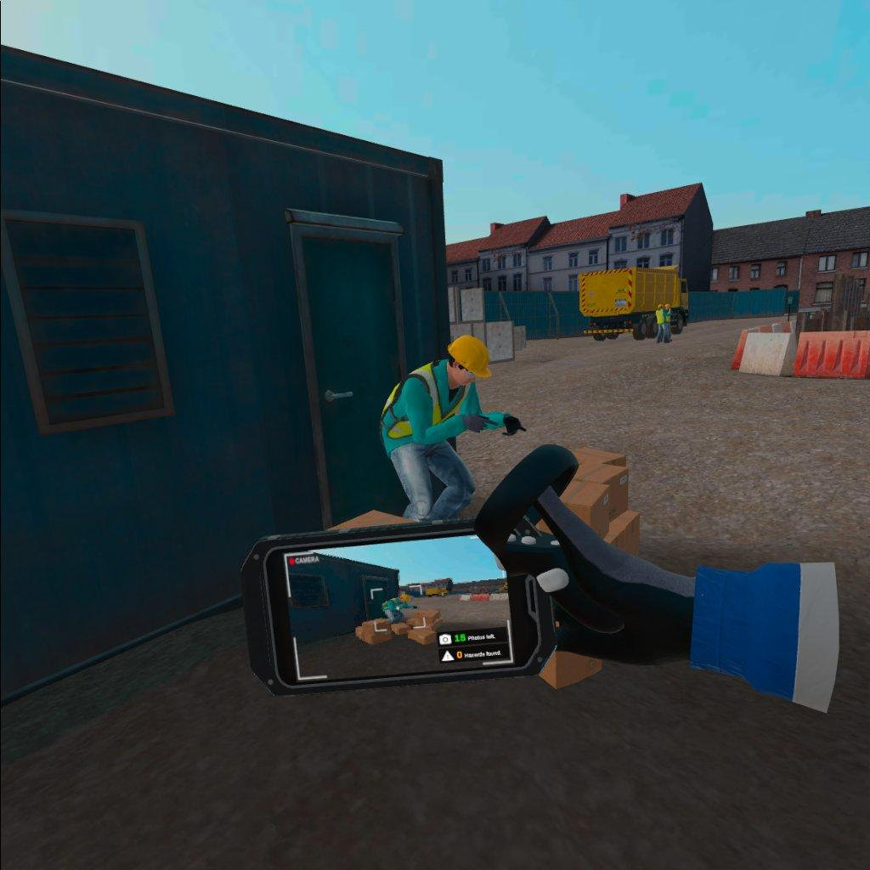
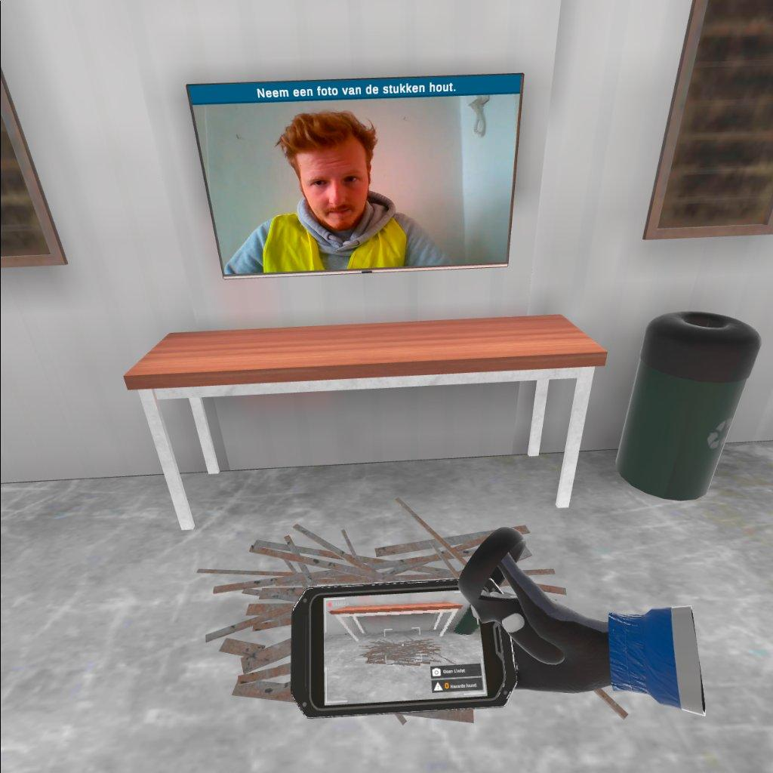
VIRTUAL REALITY IN HET ONDERWIJS: VOORBIJ DE HYPE
Carl Boel – Thomas More, UGent

Slide 3
Het gevoel “daar te zijn”
Immersion /vs/ presence
Freina & Ott (2015): immersion (<Jennett et al. (2008) = “the involvement in the play, which causes lack of awareness of time and of the real world, as well as a sense of “being” in the task environment” = engagement
Draper, Kaber, & Usher (1998): presence = “a mental state in which a user feels physically present within the computermediated environment”
Notes:
Freina & Ott (2015): https://progesis.itd.cnr.it/download/eLSE%202015%20Freina%20Ott%20Paper.pdf
Draper, J.V., Kaber, D.B. & Usher, J.M. Telepresence. Human Factors 40, 354- 375 (1998).

Slide 4
Presence
= “the subjective experience or a sense of ‘being there’ in the environment” (Southgate et al., 2019)
Notes:
https://link.springer.com/chapter/10.1007/978-94-017-9088-8_16

Slide 5
Flow theory (Nakamura & Csikszentmihalyi)
“one enters a subjective state with the following characteristics:
Intense and focused concentration on what one is doing in the present moment
Merging of action and awareness
Loss of reflective self-consciousness (i.e., loss of awareness of oneself as a social actor)
A sense that one can control one’s actions; that is, a sense that one can in principle deal with the situation because one knows how to respond to whatever happens next
Distortion of temporal experience (typically, a sense that time has passed faster than normal)
Experience of the activity as intrinsically rewarding, such that often the end goal is just an excuse for the process.”
Notes:
https://link.springer.com/chapter/10.1007/978-94-017-9088-8_16

Slide 6
Immersion
= “an objective and quantifiable description of what any particular system does provide [to contribute to the sense of presence]”
(Slater & Wilbur, 1997)

Slide 7
Immersion
Notes:
Suh & Prophet, 2018

Slide 8
Immersieve technologieën
Notes:
Milgram, P., & Kishino, F. (1994). A taxonomy of mixed reality visual displays. IEICE TRANSACTIONS on Information and Systems, 77(12), 1321-1329.

Slide 9
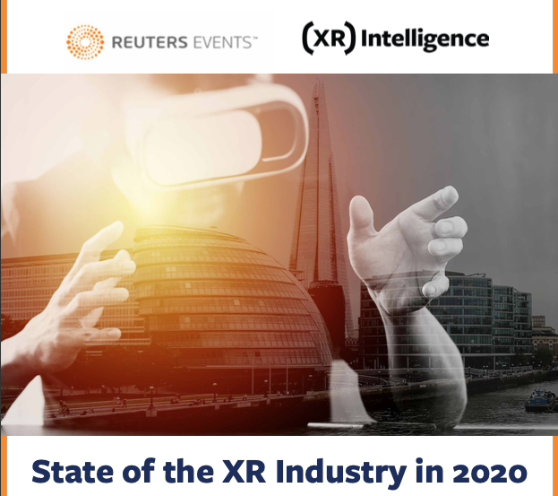
Notes:
https://eloqua.vr-intelligence.com/LP=26738?extsource=media_partner_ar_post_whitepaper

Slide 10
AR, VR, XR, MR?
XR – extended reality
Notes:
https://www.trekk.com/insights/augmented-or-virtual-how-do-you-your-reality

Slide 11
Virtual reality in het onderwijs: voorbij de hype
Waarom zou ik virtual reality gebruiken in mijn les?

Slide 12
IMMERSION
PRESENCE
OUTCOMES
Notes:
Freina & Ott, 2018, p. 87

Slide 13
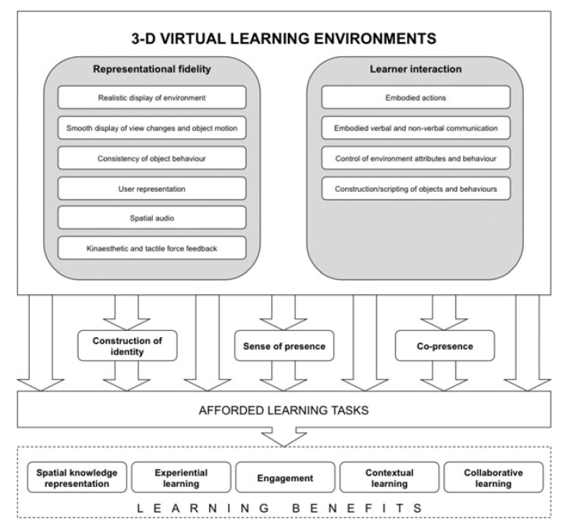
Affordances
Notes:
Shin, D. H. (2017). The role of affordance in the experience of virtual reality learning: Technological and affective affordances in virtual reality. Telematics and Informatics, 34(8), 1826-1836.

Slide 14
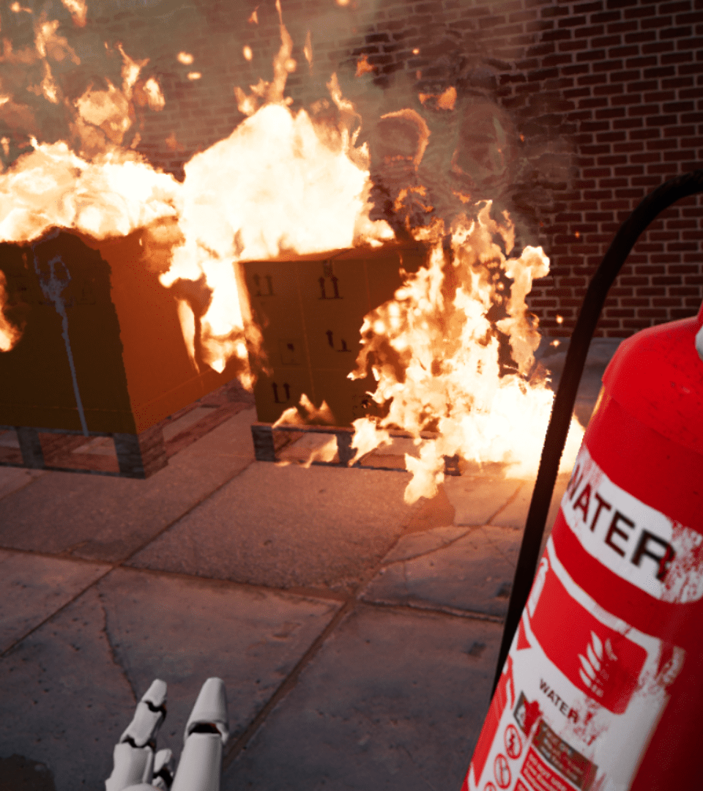
VR Learning affordances
Geen gevaar voor jezelf of anderen
Geen verlies van materiaal
Geen complexe organisatie
Notes:
Gibson, J. J. (2014). The Theory of Affordances. In The Ecological Approach to Visual Perception (pp. 119–135).

Slide 15
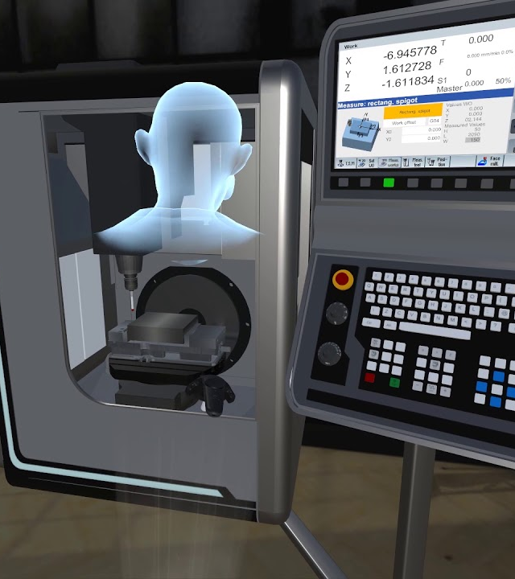
VR Learning affordances
Geen aankoop van machines
Geen transport van machines
Geen schade aan machines
Geen verlies van materiaal (scrap)
Geen tekort aan materiaal of stoffen
Notes:
Gibson, J. J. (2014). The Theory of Affordances. In The Ecological Approach to Visual Perception (pp. 119–135).

Slide 16
VR Learning affordances
Geen verre verplaatsingen
Distance learning
Asynchroon
Collaborative synchroon
Notes:
Gibson, J. J. (2014). The Theory of Affordances. In The Ecological Approach to Visual Perception (pp. 119–135).

Slide 17
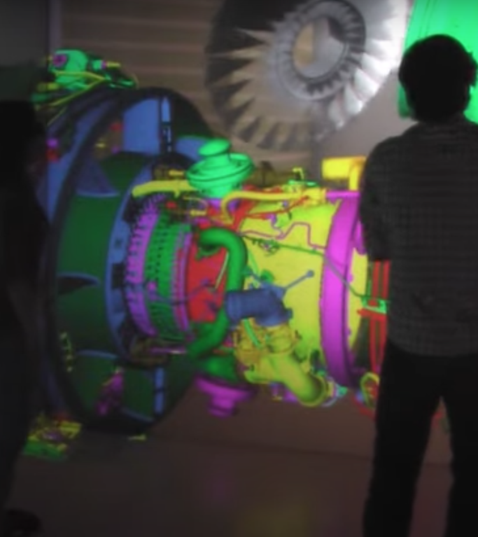
VR Learning affordances
Onzichtbare tonen
Abstracte visualiseren
Learning by doing
Pauzeren, versnellen, vertragen…
Notes:
Gibson, J. J. (2014). The Theory of Affordances. In The Ecological Approach to Visual Perception (pp. 119–135).

Slide 18
VR Learning affordances
In ander lichaam plaatsen
Empathie
Ervaringsgericht leren
Onbeperkte oefenkansen
Notes:
Gibson, J. J. (2014). The Theory of Affordances. In The Ecological Approach to Visual Perception (pp. 119–135).

Slide 19
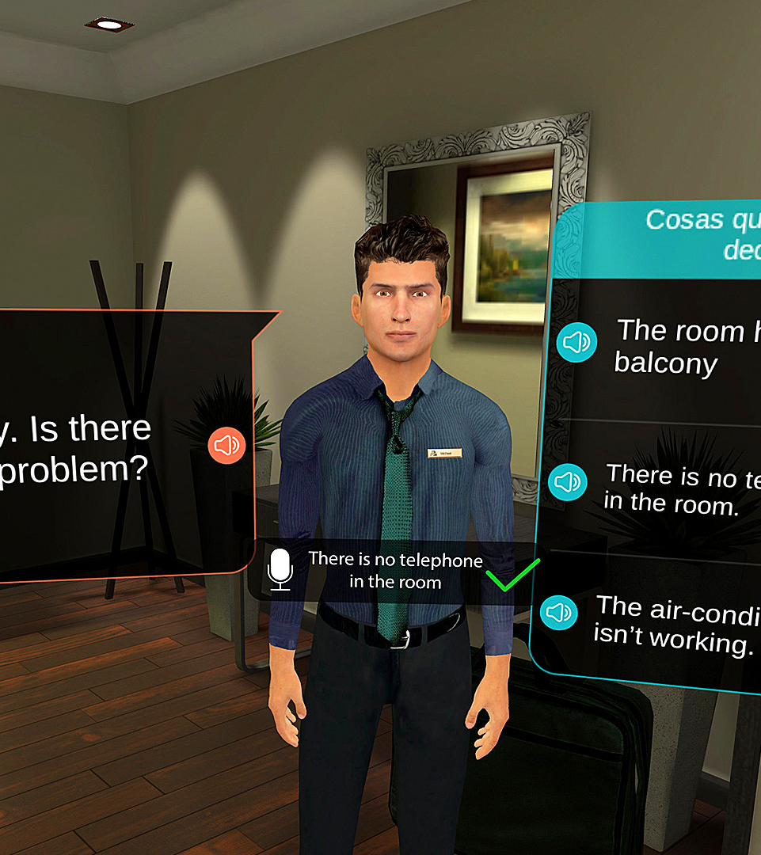
VR Learning affordances
Veilig oefenen
Authentiek oefenen
Onbeperkte oefenkansen
Adaptief leren
Notes:
Gibson, J. J. (2014). The Theory of Affordances. In The Ecological Approach to Visual Perception (pp. 119–135).

Slide 20
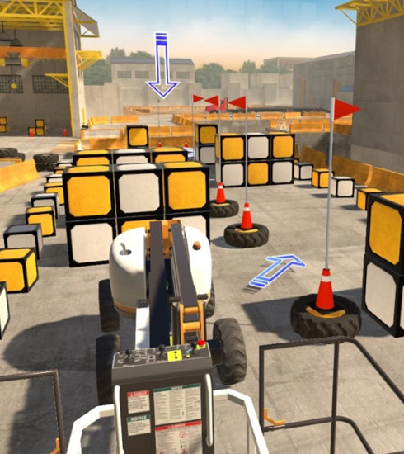
VR (technological) learning affordances
Cues
Visual
Haptic
Notes:
Gibson, J. J. (2014). The Theory of Affordances. In The Ecological Approach to Visual Perception (pp. 119–135).

Slide 21
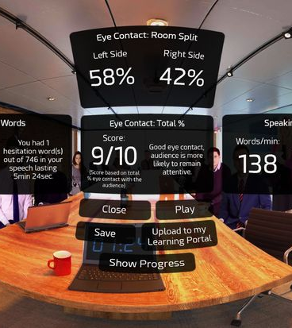
VR (technological) learning affordances
Feedback
Visual feedback
Continuous feedback
Haptic feedback
Virtual assistant
Notes:
Gibson, J. J. (2014). The Theory of Affordances. In The Ecological Approach to Visual Perception (pp. 119–135).

Slide 22
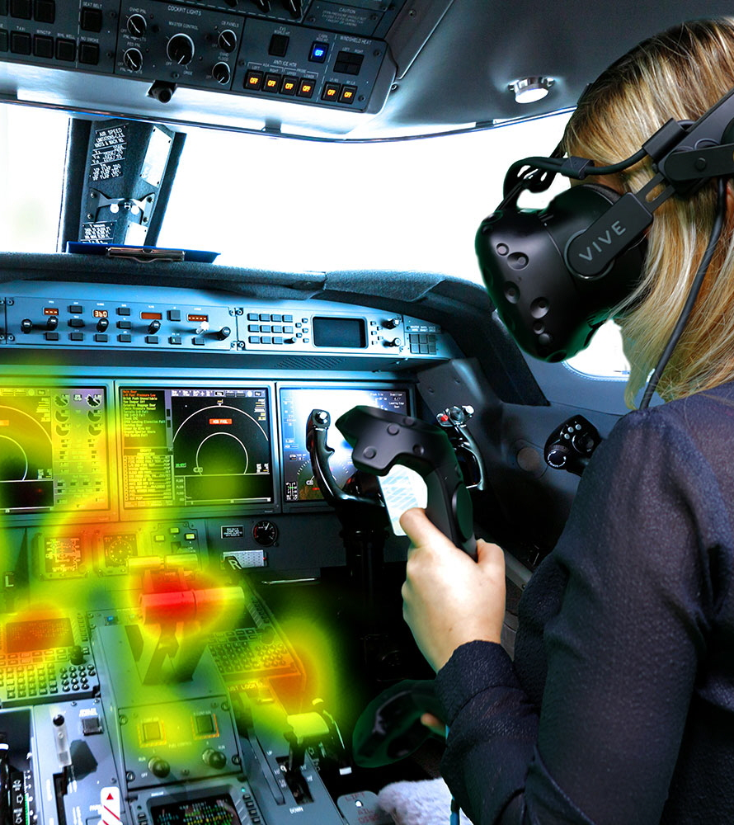
VR (technological) learning affordances
Analytics
Visual
Speech
Body
Controls
Notes:
Gibson, J. J. (2014). The Theory of Affordances. In The Ecological Approach to Visual Perception (pp. 119–135).

Slide 23
Virtual reality in het onderwijs: voorbij de hype
Het ziet er leuk uit, maar is het nu ook effectief?

Slide 24
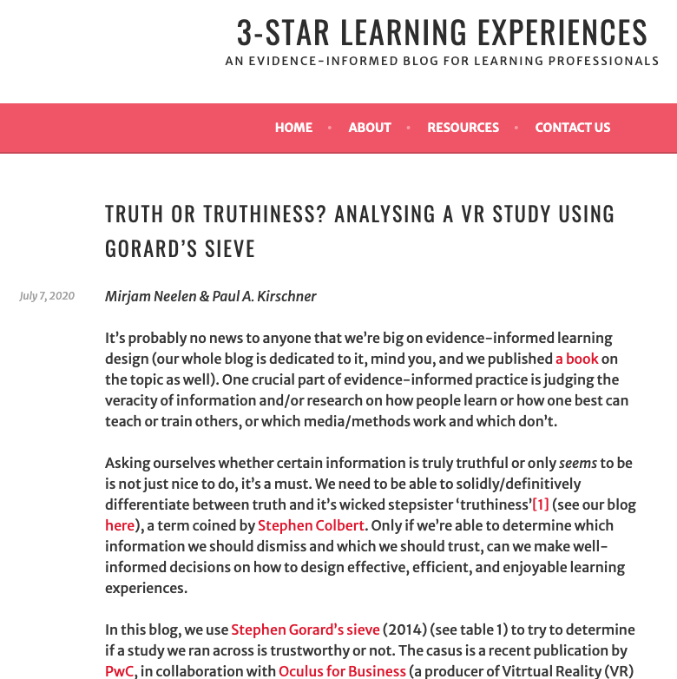
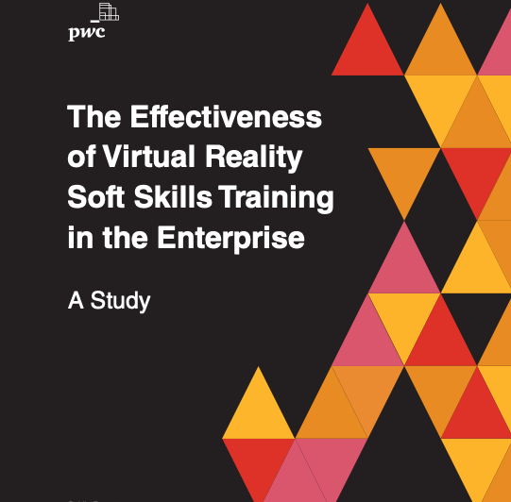
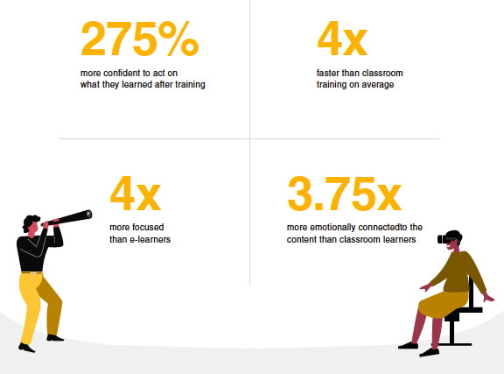
Notes:
https://www.pwc.com/us/en/services/consulting/technology/emerging-technology/assets/pwc-understanding-the-effectiveness-of-soft-skills-training-in-the-enterprise-a-study.pdf

Slide 25
The key findings of the moderator analysis were that HMDs have a greater impact
on K-12 learners;
in the fields of science education and specific abilities development;
when offering simulation or virtual world representations;
when compared with lectures or real-world practices.
The results showed that IVR using HMDs is more effective than
non-immersive learning approaches with a small effect size (0.24).

Slide 26
Virtual reality in het onderwijs: de hype voorbij
Ik ben overtuigd, hoe begin ik?

Slide 27
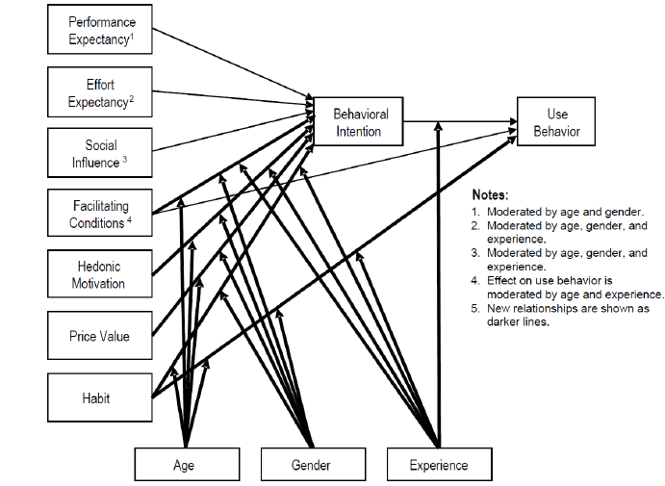

Slide 28
Principals
IT staff
Educational organisations
Teachers

Slide 30
Element (= code) | Factor (= category) | Exemplary quote (= meaning unit)
Learning by doing | Performance expectancy | “you can actually grab things and do something with them”
Visualisation | Performance expectancy | “specific learning concepts can be visualized better”
Setup | Effort expectancy | “it has to be easy to set up and get started. That’s a big conditional”
Usability | Effort expectancy | “the more user friendly and easier to handle, the better”
Enterprise content | Facilitating conditions | “there is a lot of protectionism in the market”
Management | Facilitating conditions | “who will maintain this technology? This is very important”
Colleagues same course | Social influence | “some in the department have to be addressed to introduce the technology. If they have started with it, the rest will follow.”
Principal | Social influence | “the principal will be supportive, but cannot force it to teachers”
Pleasure | Hedonic motivation | “I was really impressed… overwhelmed… very positive indeed”
Initial investment | Price value | “on the one hand you have to buy sets, and on the other hand experiences too”
Return | Price value | “the more we use it, the less it will cost”
Prior experience | Habit | “it will be easier if they have the habit of using new technologies”
UTAUT 2

Slide 31
Element (= code) | Factor (= category) | Exemplary quote (= meaning unit)
School’s innovativeness | Organisation attributes | “we have the ambition to be progressive”
Digital innovation strategy | Organisation attributes | “we work with satellites strategically”
School pedagogy | Organisation attributes | “we have an open culture of learning”
Budget of schools | Organisation attributes | “we’re in a sector with limited financial resources”
Scale | Location attributes | “we need an overarching, central hub to share materials”
Government policy | Location attributes | “the government should provide for freedom in educational curriculum policy”
Own pedagogical views | User attributes | “it should fit the way how I want to teach”
Personal innovativeness | User attributes | “the interest of a teacher plays an important role”
Authenticity | User attributes | “if you don’t show passion, enthusiasm will be adversely impacted”
Need for control | User attributes | “a teacher wants to have control on what students are doing”
Personal motivation | User attributes | “an open attitude will ensure teachers not to quit, when the first experience was not a success”
NEW

Slide 32
XR developers
Enterprise
Government
Performance
Behavioral intention
Experience
Colleague
Support
School policy
Effort
Age
Gender
IT staff
Principals

Slide 33
Virtual reality in het onderwijs: voorbij de hype
Ok, dat is theorie, wat zegt de praktijk?

Slide 34
Virtual reality learning limitations studies
“experimental designs are limited in that the controlled settings may cause the subjects to act in accordance with what they believe the experiments are looking for” (Chan et al., 2017 in Suh & Prophet, 2018)
“most papers report experiments in high education or adult training “ (Freina & Ott, 2015)
“future research should move away from laboratory style experiments, and examine the use of educational VR in an authentic setting, as part of a real educational or training program” (Jensen & Konradsen, 2018)

Slide 35
Virtual reality learning limitations studies
“Conducting research in natural settings is very different from inquiry enacted in controlled, experimental, laboratory or clinical research. Classrooms are socially active, sometimes unpredictable, places that yield unique and credible insights into the deployment of technology in the field.”

Slide 36
Instructional design
250 students
6th grade elementary schools
3 conditions:
VR + lesson
lesson + VR
VR + VR
Learning outcomes
Interest
Usefullness
Self-efficacy

Slide 37
Instructional design
Learning outcomes: significantly higher for group 2 (lesson + VR)
Self-efficacy: significantly higher (pre-post) for all conditions
Usefullness: significantly higher (pre-post) for all conditions + significantly higher in group 2
Interest: significantly higher (pre-post) for all conditions, significantly higher in group 2

Slide 38
Virtual reality learning limitations, barriers
Ethical issues:
+ 13
Violence
Safe, respectful environment
Motion sickness

Slide 39
Virtual reality learning – limitations, barriers
Technical issues:
Cost of hardware, maintenance
Cost of training, support
Network issues, lagging, recognition issues …
Unsufficient realism
Usability issues: confusing UI, limited/unnatural interaction, wearability …

Slide 40
Virtual reality learning – limitations, barriers
Organisational issues:
Lack of (curriculum-aligned) content
Usefulness: ineffective experiences (‘edutainment’)
Familiarisation
Play area
Surveillance
User accounts
Manage multiple users

Slide 41
Virtual reality learning limitations,barriers
Students’ issues:
Engagement
Novelty effect
Gender
Experience
Being looked at
High cognitive load

Slide 42
Virtual reality in het onderwijs: voorbij de hype
Wat moet ik nu onthouden?

Slide 43
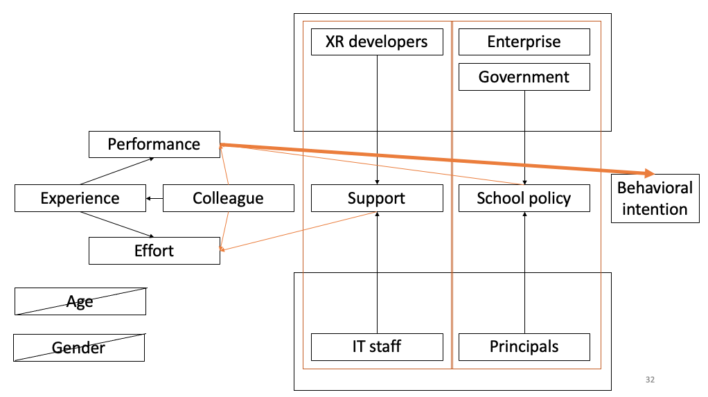

Slide 44
Conclusie
“taking into consideration and utilizing the unique affordances that comes with this new technology.”

Slide 45
Virtual reality learning affordances
Verre of onbereikbare plaatsen
Verleden
Onmogelijk (in lichaam, door ogen van anderen, in machine, ander perspectief)
Veilig oefenen: geen ongevallen
Veilig oefenen: geen schade aan materialen of anderen
Veilig oefenen: geen ‘confrontatie’ (soft skills)
Onbeperkt oefenen: geen tekort aan lokalen, machines of materialen
Onbeperkt oefenen: onbeperkte oefenkansen
Onbeperkt oefenen: herhalen, pauzeren, versnellen, vertragen, gevaarlijk
Feedback: onmiddellijk, voortdurend
Feedback: visueel, haptic
= ‘applications’ (Kavanagh, Luxton-Reilly, Wuensche, & Plimmer, 2017)

Slide 46
VR in training
VR in onderwijs
VR social
carl.boel@thomasmore.be
Doctorandus
VR in onderwijs
carl.boel@ugent.be

Slide 47
Referenties
Boel, C., Raeijmaekers, D., Rotsaert, T., Valcke, M., Schellens, T., & Struyf, D. Acceptance of immersive virtual reality in secondary education teachers. An explorative study of perceptions from teachers, it-staff, principals and teachers' trainers, In 15th International Conference on Technology,Education and Development (INTED), International Academy of Technology, Education and Development, pp. 589-596.
Boel, C., Rotsaert, T, Schellens, T, & Valcke M. (2021), Six years after Google Cardboard: what has happened in the classroom? A scoping review of empirical research on the use of immersive virtual reality in secondary education, In 13th Annual International Conference on Education and New Learning Technologies (EDULEARN), International Academy of Technology, Education and Development, pp. 7504-7513.
Boel, C., Rotsaert, T., Valcke, M., & Schellens, T. (2021). Effects and transfer of skills of a virtual reality serious game for children riding a bike, work in progress.
Boel, C, Rotsaert, T., Valcke, M, & Schellens, T. (2021). Acceptance of immersive virtual reality in secondary education teachers in Flanders. A structural equation modeling analysis, work in progress.
Bower, M. (2008). Affordance analysis–matching learning tasks with learning technologies. Educational Media International, 45(1), 3-15.
Clark, R. E. (1994). Media will never influence learning. Educational technology research and development, 42(2), 21-29.
Di Natale, A. F., Repetto, C., Riva, G., & Villani, D. (2020). Immersive virtual reality in K‐12 and higher education: A 10‐year systematic review of empirical research. British Journal of Educational Technology, 51(6), 2006-2033.
Draper, J.V., Kaber, D.B. & Usher, J.M. Telepresence. Human Factors 40, 354- 375 (1998).
Freina, L., & Ott, M. (2015, April). A literature review on immersive virtual reality in education: state of the art and perspectives. In The International Scientific Conference eLearning and Software for Education (Vol. 1, No. 133, pp. 10-1007).

Slide 48
Referenties
Gibson, J. J. (2014). The Theory of Affordances. In The Ecological Approach to Visual Perception (pp. 119–135).
Jensen, L., & Konradsen, F. (2018). A review of the use of virtual reality head-mounted displays in education and training. Education and Information Technologies, 23(4), 1515-1529.
Kavanagh, S., Luxton-Reilly, A., Wuensche, B., & Plimmer, B. (2017). A systematic review of Virtual Reality in education. Themes in Science and Technology Education, 10(2), 85-119.
Makransky, G., Terkildsen, T. S., & Mayer, R. E. (2019). Adding immersive virtual reality to a science lab simulation causes more presence but less learning. Learning and Instruction, 60, 225-236.
Merchant, Z., Goetz, E. T., Cifuentes, L., Keeney-Kennicutt, W., & Davis, T. J. (2014). Effectiveness of virtual reality-based instruction on students' learning outcomes in K-12 and higher education: A meta-analysis. Computers & Education, 70, 29-40.
Milgram, P., & Kishino, F. (1994). A taxonomy of mixed reality visual displays. IEICE TRANSACTIONS on Information and Systems, 77(12), 1321-1329.
Nakamura J., Csikszentmihalyi M. (2014) The Concept of Flow. In: Flow and the Foundations of Positive Psychology. Springer, Dordrecht
Neelen, M. & Kirschner, P.A. (2020). TRUTH OR TRUTHINESS? ANALYSING A VR STUDY USING GORARD’S SIEVE. Opgehaald van https://3starlearningexperiences.wordpress.com/2020/07/07/truth-or-truthiness-analysing-a-vr-study-using-gorards-sieve/

Slide 49
Referenties
PwC (2020). The Effectiveness of Virtual Reality Soft Skills Training in the Enterprise. A Study. Opgehaald van https://www.pwc.com/us/en/services/consulting/technology/emerging-technology/assets/pwc-understanding-the-effectiveness-of-soft-skills-training-in-the-enterprise-a-study.pdf
Radianti, J., Majchrzak, T. A., Fromm, J., & Wohlgenannt, I. (2020). A systematic review of immersive virtual reality applications for higher education: Design elements, lessons learned, and research agenda. Computers & Education, 147, 103778.
Shin, D. H. (2017). The role of affordance in the experience of virtual reality learning: Technological and affective affordances in virtual reality. Telematics and Informatics, 34(8), 1826-1836.
Slater, M., & Wilbur, S. (1997). A framework for immersive virtual environments (FIVE): Speculations on the role of presence in virtual environments. Presence: Teleoperators & Virtual Environments, 6(6), 603-616.
Southgate, E., Smith, S. P., Cividino, C., Saxby, S., Kilham, J., Eather, G., ... & Bergin, C. (2019). Embedding immersive virtual reality in classrooms: Ethical, organisational and educational lessons in bridging research and practice. International journal of child-computer interaction, 19, 19-29.
Suh, A., & Prophet, J. (2018). The state of immersive technology research: A literature analysis. Computers in Human Behavior, 86, 77-90.
Wu, B., Yu, X., & Gu, X. (2020). Effectiveness of immersive virtual reality using head‐mounted displays on learning performance: A meta‐analysis. British Journal of Educational Technology, 51(6), 1991-2005.

